Slide 1




MBC 638: Data Analysis & Decision Making
Anna Chernobai
Lecture 05 – PART 1:
Simple and multiple regressions (Chapter 10)

Slide 2
Regression analysis
Regression analysis is one of the most powerful tools for a business analyst!
Examples of applications:
How do salaries of employees depend on years of experience, years of education, and gender?
How does the current price of a stock depend on its own past values, as well as the current and past values of a market index?
How does the selling price of a house depend on such factors as the appraised value, square footage, number of bedrooms in the house, number of baths, and geographical location?
How does the probability of bankruptcy depend on a firm’s profitability, distance-to-default, firm size, executive compensation’s stock price sensitivity, and governance such as the proportion of independent directors on the board?

Slide 3
Today: Regression analysis
0. Recall (Lecture 04): Association among numerical variables
Scatterplots
Covariance and Correlation
Simple linear regression
Multiple linear regression
Linear regressions with dummy variables and interaction variables
Nonlinear modeling possibilities

Slide 4

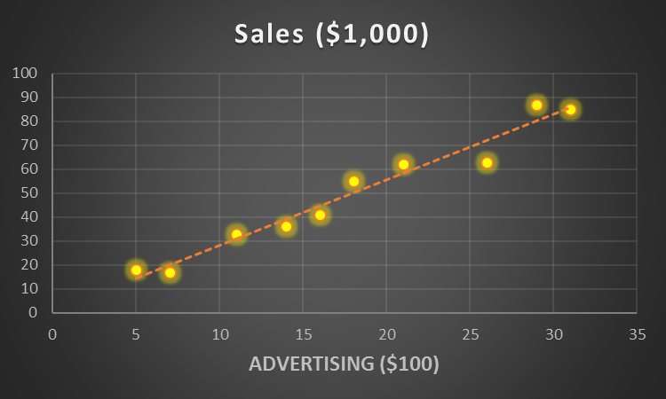
0. Association among numerical variables
Example
Advertising and Sales
Advertising ($100) | Sales ($1,000)
18 | 55
7 | 17
14 | 36
31 | 85
21 | 62
5 | 18
11 | 33
16 | 41
26 | 63
29 | 87
This table contains weekly sales (in $’000) and advertising expenditures (in $’00) for 10 branches of a retail store.
We want to understand how advertising expenditures affect sales.
X = predictor = explanatory variable = independent variable
Y = response variable = dependent variable
X Y

Slide 5
0. Association among numerical variables
Graphical techniques to display association:
Scatterplot (2 variables)
Numerical techniques to display association:
Univariate (descriptive):
Covariance (2 variables)
Correlation (2 variables)
Regression (simple regression: 1 predictor)
Multivariate:
Regression (multiple regression: 2 or more predictors)

Slide 6
Today: Regression analysis
0. Recall (Lecture 04): Association among numerical variables
Scatterplots
Covariance and Correlation
Simple linear regression
Multiple linear regression
Linear regressions with dummy variables and interaction variables
Nonlinear modeling possibilities

Slide 7
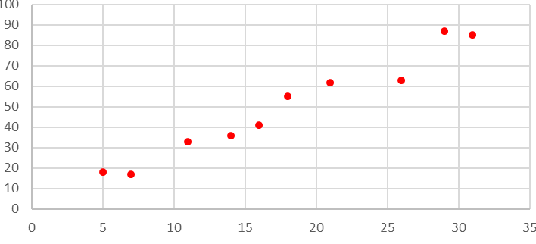
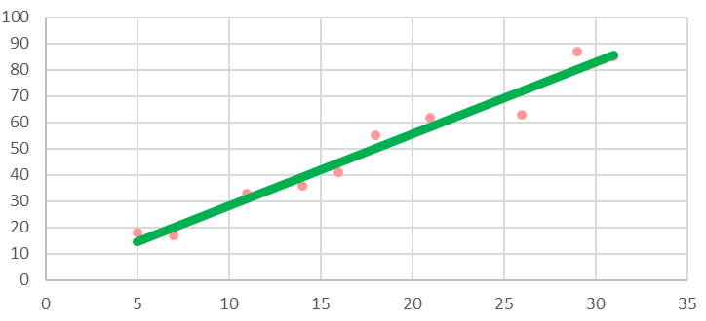
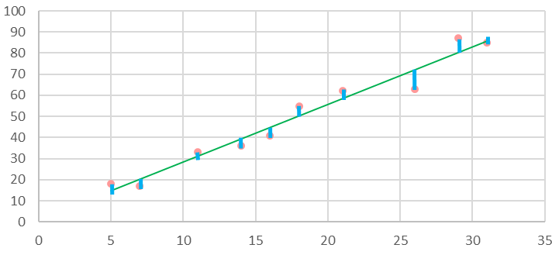
3. Simple linear regression
actual values of Y = predicted values of Y + errors
Predicted values of Y depend on X and follow a straight line.
Regression equation:
ŷ = b₀ + b₁ · x
error
Predicted value of Y intercept slope explanatory variable

Slide 8

1. Simple linear regression
Example
Excel output:
Advertising expenditures and sales:
Regression equation: ŷ = 1.02 + 2.73 · x
X = advertising expenses ($’00), weekly
Y = sales ($’000), weekly

Slide 9
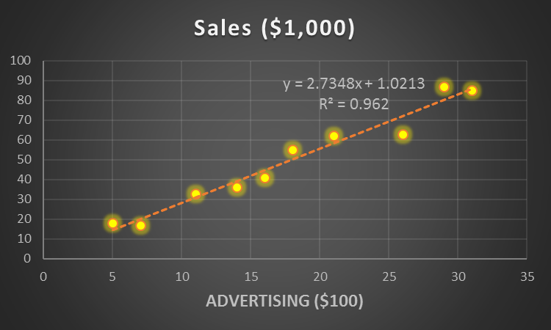
1. Simple linear regression
Advertising and sales ŷ = 1.02 + 2.73 · x
Example

Slide 10
1. Simple linear regression
Advertising and sales ŷ = 1.02 + 2.73 · x
Example
Advertising ($100) | Sales ACTUAL ($1,000) | Sales PREDICTED ($1,000)
18 | 55 | 50.2
7 | 17 | 20.2
14 | 36 | 39.3
31 | 85 | 85.8
21 | 62 | 58.5
5 | 18 | 14.7
11 | 33 | 31.1
16 | 41 | 44.8
26 | 63 | 72.1
29 | 87 | 80.3
X Y Ŷ

Slide 11
1. Simple linear regression
Advertising and sales ŷ = 1.02 + 2.73 · x
Example
Advertising ($100) | Sales ACTUAL ($1,000) | Sales PREDICTED ($1,000)
18 | 55 | 50.2
7 | 17 | 20.2
14 | 36 | 39.3
31 | 85 | 85.8
21 | 62 | 58.5
5 | 18 | 14.7
11 | 33 | 31.1
16 | 41 | 44.8
26 | 63 | 72.1
29 | 87 | 80.3
Ŷ=72.1
Y=63
Error = -9.1
X=26
X Y Ŷ

Slide 12
1. Simple linear regression
Advertising and sales ŷ = 1.02 + 2.73 · x
X = advertising expenses ($’00) weekly
Y = sales ($’000), weekly
Interpretation:
Intercept =
Slope =
Example

Slide 13
1. Simple linear regression
Regression line:
Ŷ = 1.02 + 2.73*X
Understanding intercept & slope
Sales (Y) ‘000
2.73
$2,730 predicted increase
(= 2.73 unit increase)
in sales
1
1.02
0
20 21
Advertising (X) ‘00
ŷ = 1.02 + 2.73 · x
$100 increase
(= 1 unit increase)
in advertising expenses

Slide 14
1. Simple linear regression
Example
Regression equation:
Predicted Revenue = 1,293 + 0.317 * # Employees
($mln) (‘000)
Interpretation:
Intercept: …
Slope: …

Slide 15
1. Simple linear regression
Regressions are useful for making predictions.
Example
Regression equation:
X = advertising expenses ($’00), weekly
Y = sales ($’000), weekly
Q: Predict the value of weekly sales for weekly advertising expenses = $300.
A:
ŷ = 1.02 + 2.73 · x

Slide 16
1. Simple linear regression
Estimating the two coefficients
Slope:
Intercept:

Slide 17
1. Simple linear regression
Estimating the two coefficients
Intuitively:
Find intercept and slope that would produce a straight line such that all errors are minimized.
Ordinary Least Squares (OLS) method:
Find b₀ and b₁ to minimize Sum of all Squared Errors.
y
ŷ=b₀+b₁x
Vertical distances between actual and predicted values
y₂
ŷ₂
e²₂=(y₂-ŷ₂)²
ŷ₁
e²₁=(y₁-ŷ₁)²
y₁
x₁ x₂ x₃ x₄ x₅ x₆ x₇
x
ŷ = b₀+b₁x

Slide 18
1. Simple linear regression
y
ŷ
y
Slope =
Slope=0
ŷ
Intercept =
Intercept = ?
0
x
0
x
Question: What is the interpretation of the intercept when slope = 0?

Slide 19
1. Simple linear regression
Evaluating the “goodness of fit” of the linear model
Once the linear model is estimated, it needs to be assessed.
Q: Do I have a good linear model?
Q: Is variable X a good predictor of Y?
Q: How much of my Y is explained by my X?
All these questions are answered by R² = the coefficient of determination

Slide 20
1. Simple linear regression
The coefficient of determination R² is the squared correlation coefficient *
R²
0 ≤ r² ≤ +1
r² shows how much of variability in Y is explained by variability in X (i.e., how much is explained by the linear model)
r² shows how good the linear model is
The closer to +1, the better the model
* Only for simple regressions (one X). For multiple regressions (many X), R² is not equal to the squared correlation coefficients. The formula is much more complicated.

Slide 21
1. Simple linear regression
Advertising expenditures and sales
Regression equation: ŷ = 1.02 + 2.73 · x
X = advertising expenses ($’00), weekly
Y = sales ($’000), weekly
Example
Interpretation: 96.2% of variability in sales is explained by variability in advertising expenses.

Slide 22
1. Simple linear regression
Advertising expenditures and sales:
Regression equation: ŷ = 1.02 + 2.73 · x
X = advertising expenses ($’00), weekly
Y = sales ($’000), weekly
Example
n = #obs.
k = #params.

Slide 23
1. Simple linear regression
Advertising expenditures and sales:
Regression equation: ŷ = 1.02 + 2.73 · x
X = advertising expenses ($’00), weekly
Y = sales ($’000), weekly
Example
We will cover these later in the semester

Slide 24
1. Simple linear regression
In regressions, we often need to handle outliers…

Slide 25
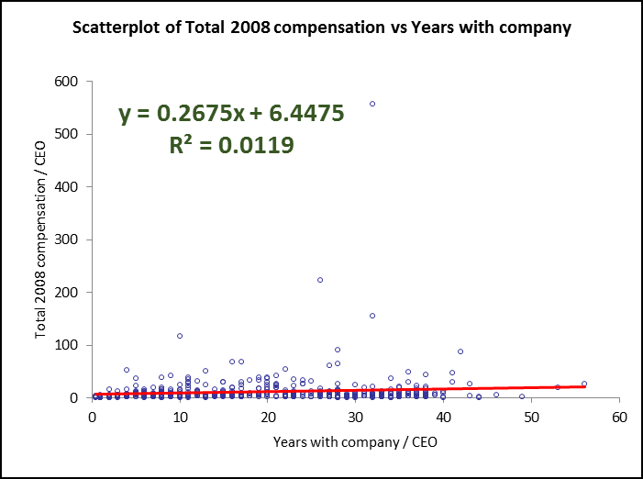
1. Simple linear regression
CEO compensation: Years with company vs. total compensation
Outliers
Total 2008 Compensation variable has outliers
Total 2008 compensation
Years with company

Slide 26
1. Simple linear regression
Dealing with outliers
Approach #1: Remove outliers from the data. Problem: You must have a good justification for doing so (e.g., a data entry error)!
Approach #2: Suppress outliers.
Winsorizing. E.g., winsorizing top 5% of data in a particular variable means setting all data values above the 95th percentile equal to the 95th percentile.
Log-transformation of right-skewed data. Take natural logarithm of the variable that has a large dispersion. Drawback: Can only do so for positive data variables. This technique is commonly used for dollar-denominated variables, e.g., income, MVE, total assets.
When is it a good idea to suppress outliers? A quick check: Compare sample mean with sample median (or just look at the histogram!), and suppress outliers if the mean is much higher than the median (i.e., the data is severely right-skewed).

Slide 27
1. Simple linear regression
CEO compensation: Years with company vs. total compensation
Outliers
Total 2008 Compensation variable has outliers (is very right-skewed)
Mean = $ 11.43 mln
Median = $ 5.39 mln
Total 2008 compensation
Years with company

Slide 28
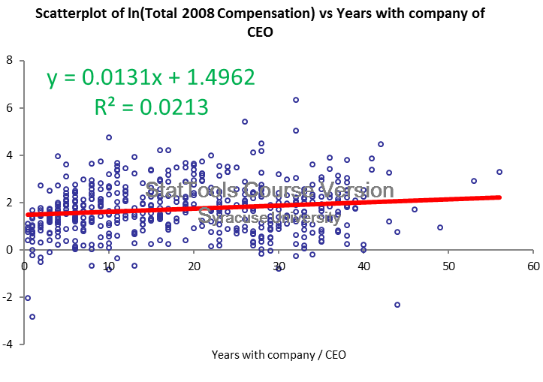
1. Simple linear regression
Example
CEO compensation: Years with company vs. Ln total compensation
Total 2008 compensation
Ln Total 2008 compensation
Years with company
Years with company
r = 0.109 r = 0.146

Slide 29
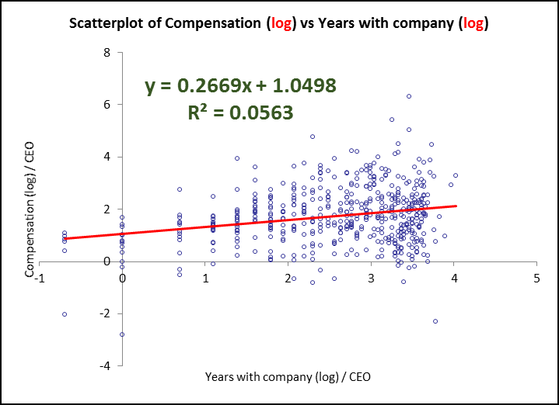
1. Simple linear regression
Example
CEO compensation: Ln years with company vs. Ln total compensation
Total 2008 compensation
Ln Total 2008 compensation
Years with company
Ln Years with company
r = 0.109 r = 0.237

Slide 30
1. Simple linear regression
Example
CEO compensation: 6-yr ave. compensation vs. 6-yr ave. return
Relative to industry (100 = industry ave.) Relative to market (100 = S&P 500)
r = 0.111 r = 0.188
6-yr ave compensation
6-yr ave compensation
6-yr return relative to industry
6-yr return relative to market

Slide 31
1. Simple linear regression
CEO compensation: 6-yr ave. Ln-compensation vs. 6-yr ave. return
Relative to industry (100 = industry ave.) Relative to market (100 = S&P 500)
r = 0.058 r = 0.164
Ln 6-yr ave compensation
Ln 6-yr ave compensation
6-yr return relative to industry
6-yr return relative to market

Slide 32

Today: Regression analysis
0. Recall (Lecture 04): Association among numerical variables
Scatterplots
Covariance and Correlation
Simple linear regression
Multiple linear regression
Linear regressions with dummy variables and interaction variables
Nonlinear modeling possibilities

